Slide 1
Name : Jakirul Islam
ID : 193002101
Department : CSE
Topic :Time dilation

Slide 2
Time Dilation topic
What is time dilation
Experiment proof of time dilation
Application of time dilation
Time travel

Slide 3
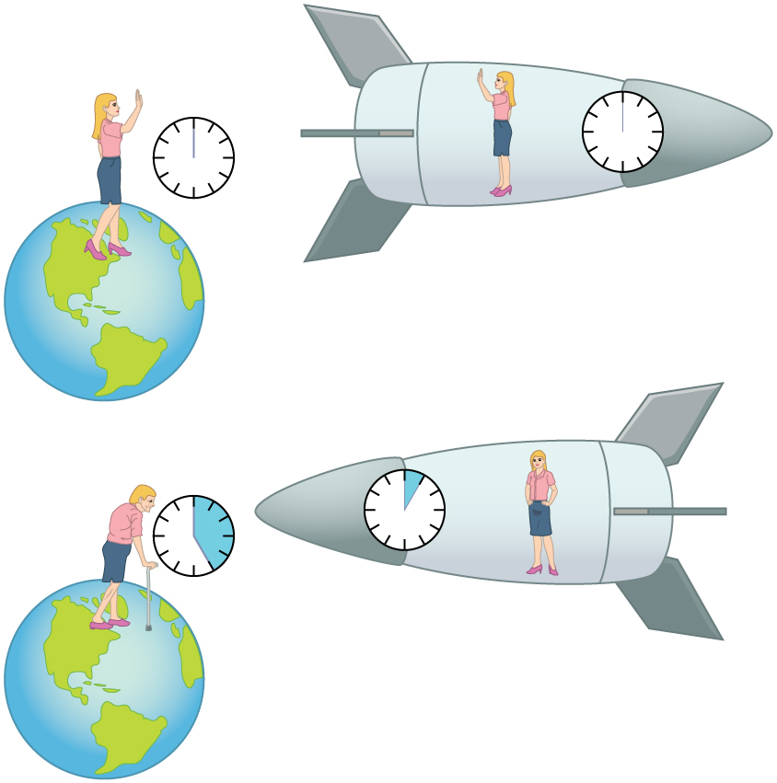
What is time dilation :
A slowing of time in accordance with the theory of
relativity that occurs in a system in motion relative to an
outside observer and that becomes apparent especially as the speed of the system approaches that of light— called also time dilatation

Slide 4
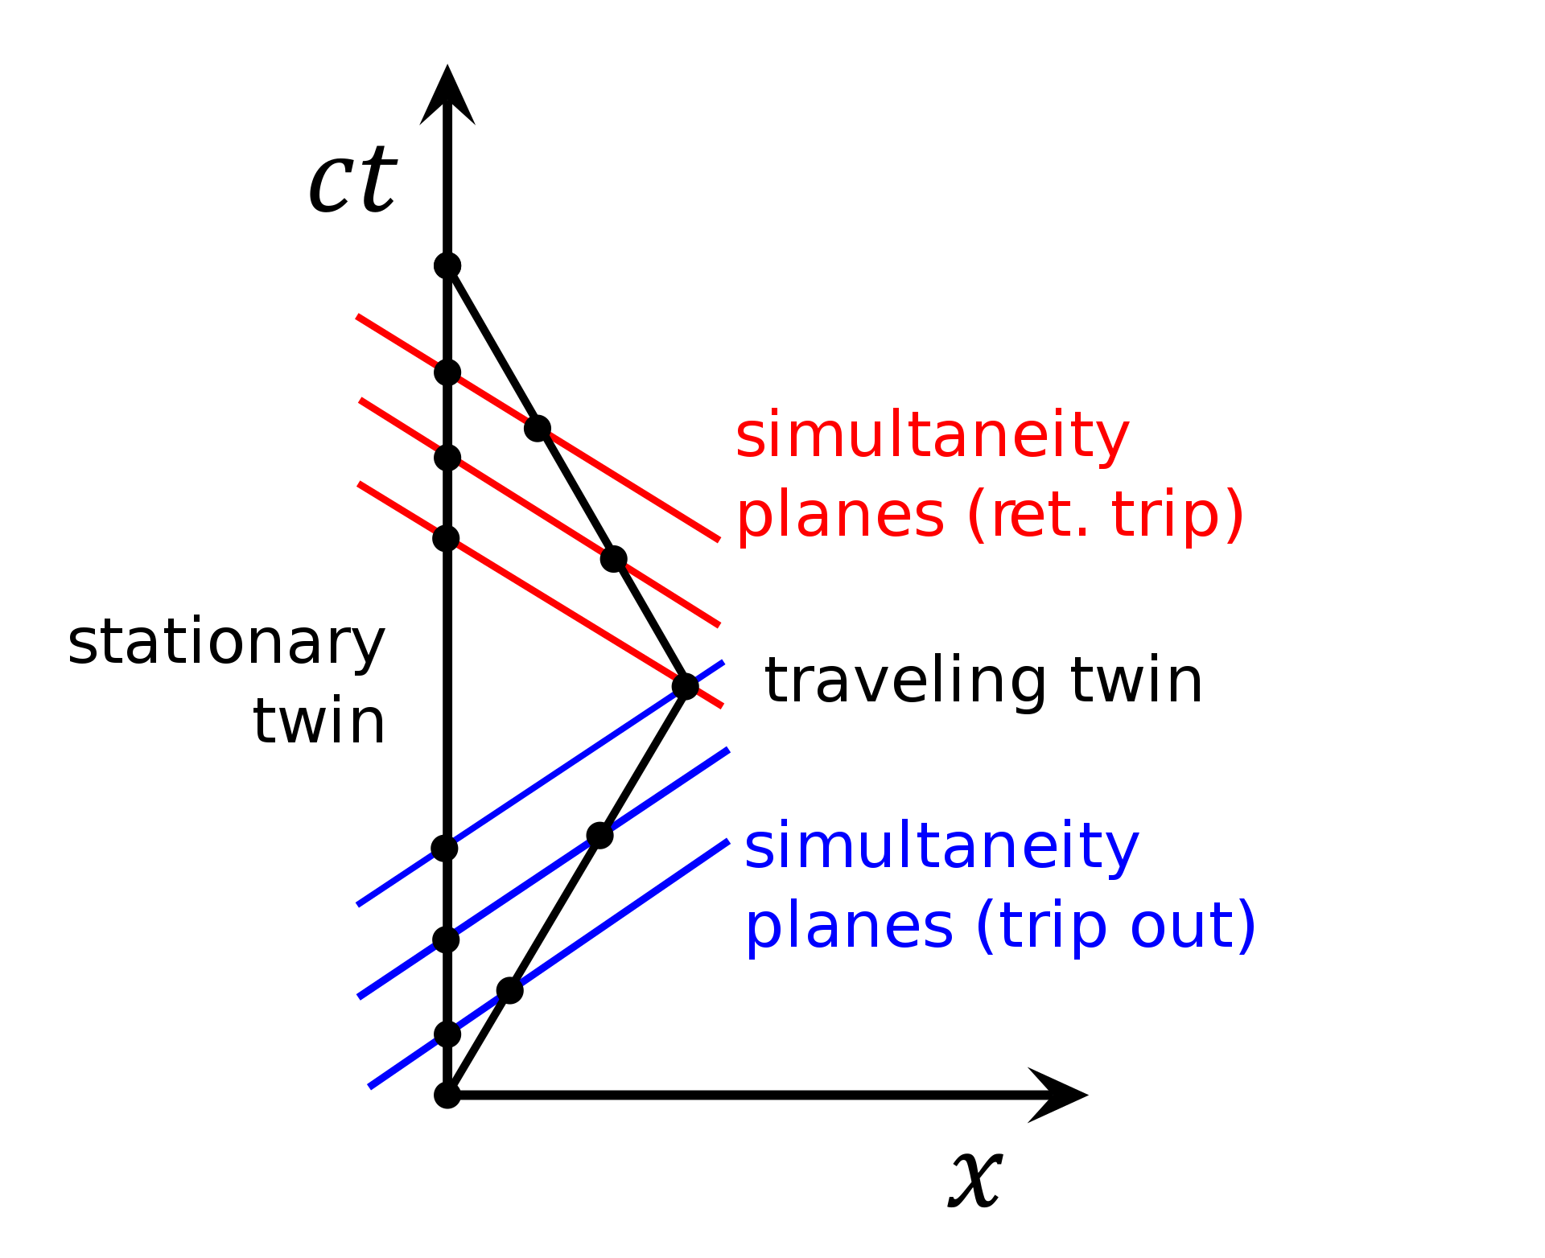
Experiment proof of time dilation :
A number of experiments exist which appear to support SR time dilation. They are: . Clocks on orbiting satellites move slower . Atomic clocks on planes move slower . Michelson-Morley experiment . Muon particles decay more slowly while falling

Slide 5
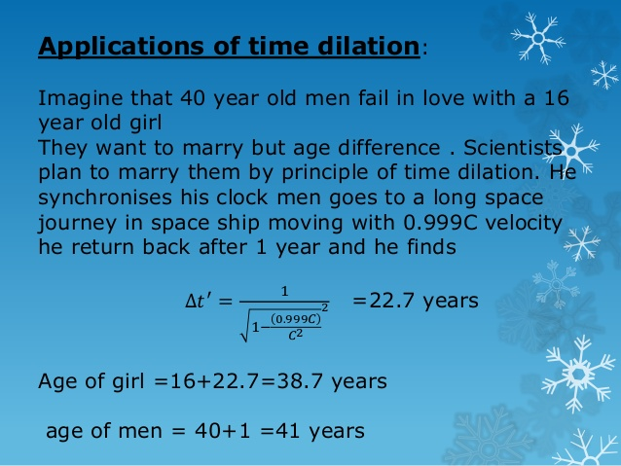
Application of time dilation :

Slide 6

Time travel :
Actually going to future and past time machine is a way to travel in time . Although it work on time dilation concept but still it is hypothetical for us because till now we are unable to make a ideal time machine . In hisostry we can see the reflection of it .
This Photo by Unknown Author is licensed under CC BY

Slide 7

Thanks

